Slide 1

Pathway analysis
Biostat & Bioinfo short course series
Jianying Li

Slide 2

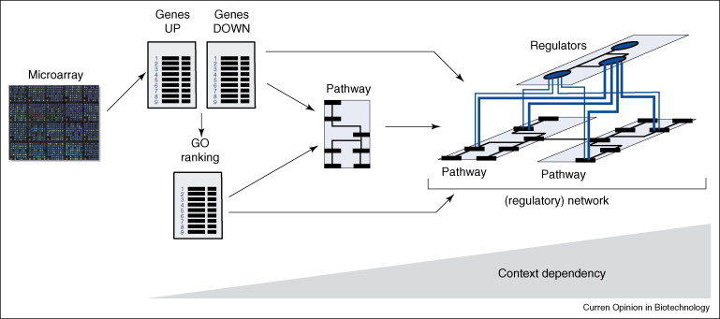
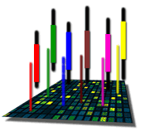
The Road to Pathway Analysis
Next Gen RNA-Seq
Adapted from Werner (2008), Current Opinion in Biotech., 19:50-64
Notes:
2

Slide 3
Outline of the pathway analysis
Knowledge based pathway analysis
Available knowledge bases
Two major statistical approaches
Parametric: Hypergeometric/Fisher Exact Test (FET)
Non-parametric: Kolmogorov-Smirnov/ranking statistics
Hands on practice
Parametric --> IPA
Non-parametric --> GSEA
The proceedings in pathway analysis research

Slide 4
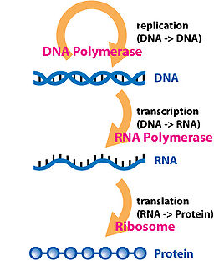
What do we mean by pathway?
Central Dogma
Involvement of Gene Products
Biological process or molecular function
Signaling cascades
Etc.
Genes are categorized based on criteria

Slide 5
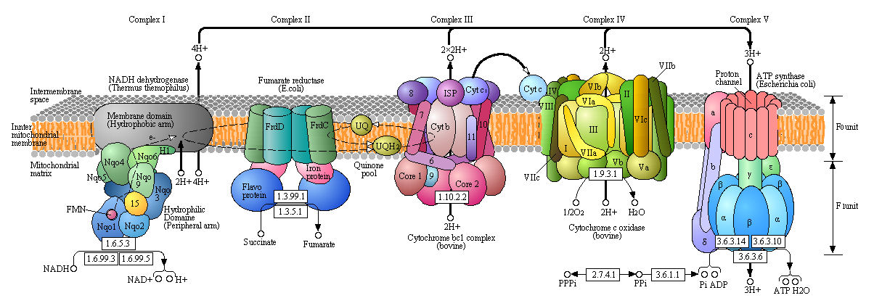
The oxidative phosphorylation
http://employees.csbsju.edu/hjakubowski/classes/ch331/oxphos/olcouplingoxphos.html

Slide 6
Gene sets (e.g. function driven)
Genes (sets) have something in common
On the same cytogenetic band
Coding for proteins that are part of the same cellular component
Can be part of the same biochemical pathway
Co-expressed under certain conditions
Putative targets of the same regulatory factor
….

Slide 7
Gene Ontology
Gene Ontology (GO) Consortium was established in 1998 to developed shared, structured vocabulary (an ontology) for the annotation of molecular characteristics across different organisms.
a collaborative effort to address the need for consistent descriptions of gene and gene products in different databases
Original members of the consortium: SGD, FlyBase and MGD
Two primary purposes for an ontology:
to facilitate communication between people and organizations
to improve upon the interoperability between systems

Slide 8
GO structure
The ontologies are structured vocabularies in the form of directed acyclic graphs (DAGs)
The DAG represents a network (not a tree) in which each term may be a child of one or more than one parent
The relationships of child to parent can be of the “is a” type or the “part of” type

Slide 9
Ontologies within GO
molecular function describing activities, such as catalytic or binding activities, at the molecular level
biological process referring to a biological objective to which the gene product contributes
cellular component referring to the place in the cell (i.e. the location) where a gene product is found

Slide 10

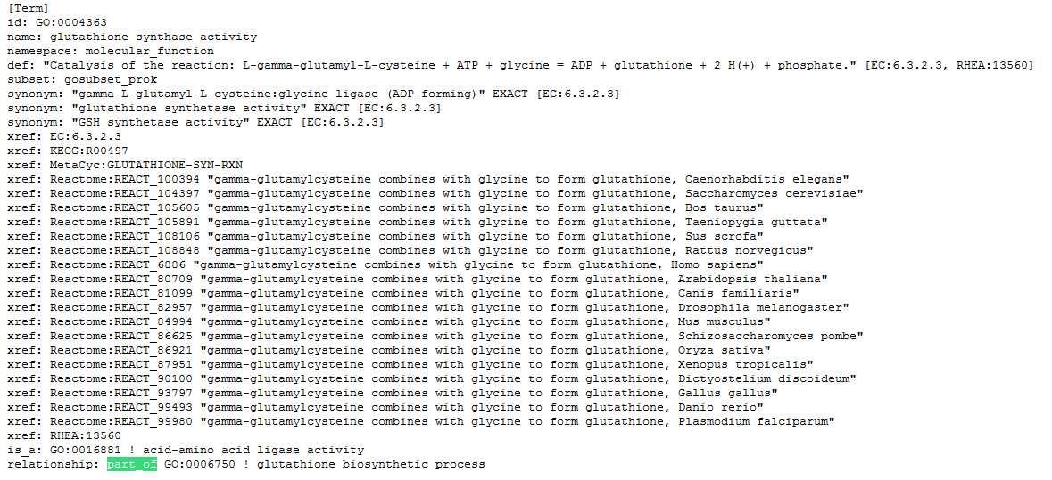
Notes:
describing activities, such as catalytic or binding activities, at the molecular level

Slide 11
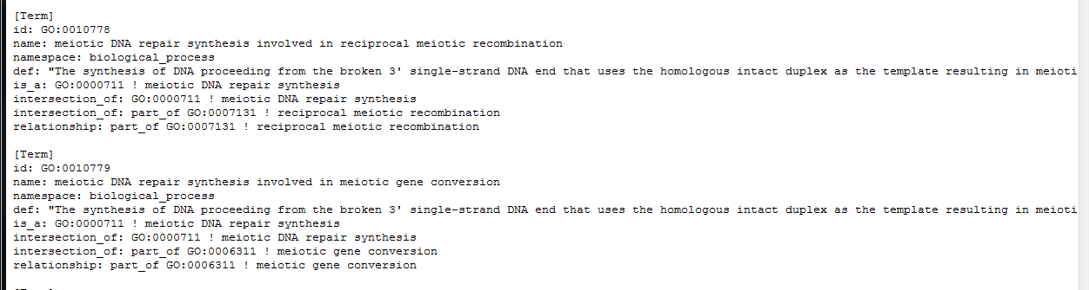
Notes:
referring to a biological objective to which the gene product contributes

Slide 12
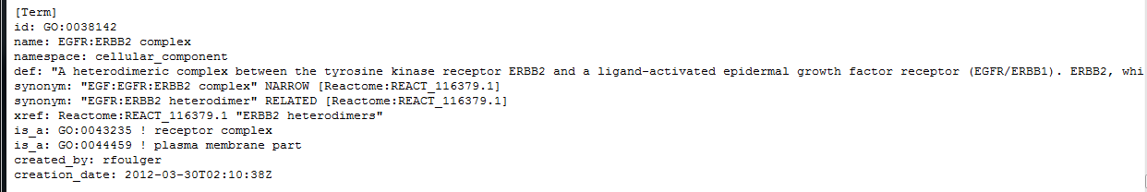
Notes:
referring to the place in the cell (i.e. the location) where a gene product is found

Slide 13
KEGG: Kyoto Encyclopedia of Genes and Genomes
About KEGG
Category in KEGG
Kyoto Encyclopedia of Genes and Genomes (KEGG) knowledgebase was developed in 1996 consisting of genetic building blocks of genes and proteins.
A collection of manually drawn pathway maps representing current knowledge on the molecular interaction and reaction networks
Manually curated based on published literature
Constructed as wiring diagrams with enzymes and proteins, processes and reactions and substrates, co-factors, intermediates, metabolites and end products
Metabolism: carbohydrates, energy, lipid, nucleotides, amino acid, xenobiotics
Genetic information processing
Environmental information processing
Cellular processes
Human diseases
Drug development: the structure relationships

Slide 14
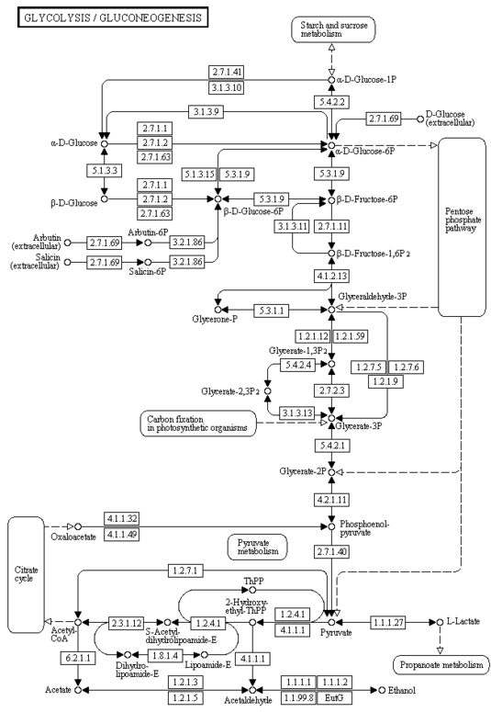

Slide 15
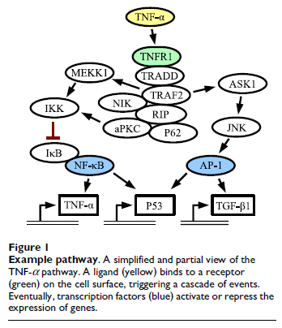
Transfac and Transpath databases --Signaling Pathways
Experimentally validated
Transfac - data on transcription factors, their experimentally-proven binding sites, and regulated genes.
The compilation of binding sites allows the derivation of positional weight matrices.
Transpath – data about protein-protein interactions and directed modification of proteins involved in signal transduction pathways,
With a particular focus on signaling
cascades that affect the activity of
transcription factors.
Breslin et al., BMC Bioinformatics, 2005, 6:163

Slide 16
More on gene set collections
Gene Ontology (GO)
Cellular components (CC)
Biological processes (BP)
Molecular functions (MF)
Well curated pathway databases
KEGG pathway
Biocarta
GenMAPP
IPA pathway database
Gene set collections
MSigDB (GSEA)
Gazer
Customized collections(GSA)

Slide 17
A parametric approach
Hypergenometric distribution and testing
A little theoretical background
Distribution density
Formulating the test
Fisher’s exact test
Two by two contingent table
One-tailed test formulation
Watch out for a common error

Slide 18
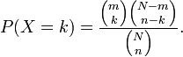
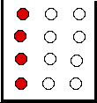
Hypergeometric Distribution
for k = 0,1,2,…,n
k<=m, n-k <=N-m
A discrete probability distribution that describes the number of successes (k) in a sequence of n draws from a finite population without replacement
An urn with two types of marbles:
N total # of marbles
Of which, m # of red marbles
Drawing a red marble is a success!
Drawing a white marble is a failure!
n is the # of marbles randomly drawn
k is the # of successes (red marbles) in the sample
Hypergeometric distribution gives the probability
P(k=2, n, m, N) = 0.339
Cumulative dist.:
P(k<=2) = 0.933

Slide 19
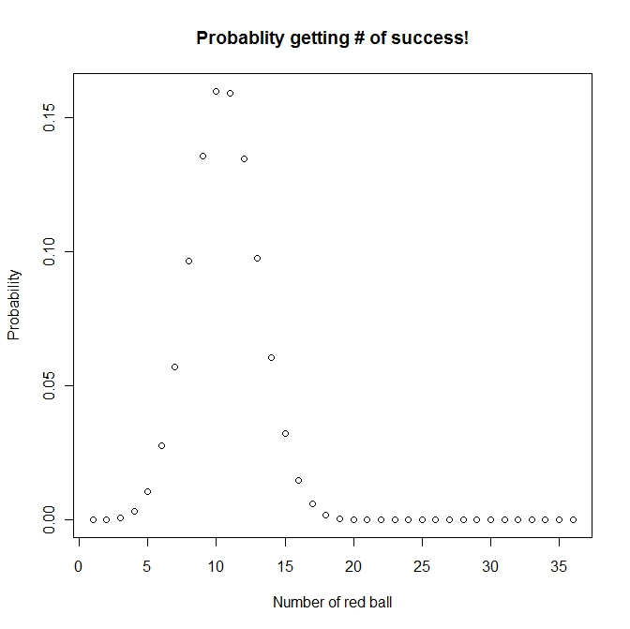
Hypergeometric distribution
m
Number of red ball: 50
Number of white ball: 120
Number of ball drawn (without replacement): 36
Possible number of success ??
(0,1, 2, ….36),
Probability to get 20 red balls is: 0.0001494571
N
n
p(k=20, 36, 50, 170),
dhyper(20,50,120,36)
http://www.aiaccess.net/English/Glossaries/GlosMod/e_gm_hypergeometric.htm

Slide 20
Rationale (an analogy)
A study with gene expression microarray, can be RNAseq also (total # of genes -- N)
Experiment samples from two or more conditions (control vs. treated, wild type vs knock out, etc.)
Several biological replicates at each condition
Differentially Expressed Genes (DEGs) obtained from statistical models (total # of genes drawn -- n)
Of which, k genes belong to a “pathway”
There are totally m genes (out of N) belong to this pathway
Is this pathway (the biological process) significantly enriched? (Perturbed? Turned on? Involved?)

Slide 21
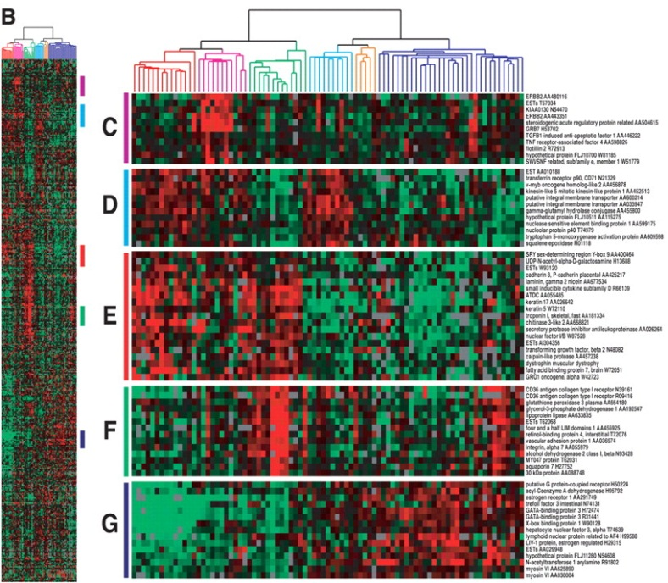
Hypergeometric Distribution/Test in the context of gene expression
Models the probability the of observing k genes from a cluster of n genes by chance in a pathway or biological process category containing m genes from a total genome (or array) size of N genes.
The p-value indicates the probability that the biological process
category (particular pathway) is enriched by this microarray
experiment by chance. The smaller the p-val, the higher the significance

Slide 22
Pathway analysis
Gene expression analysis results
Total number of gene on a chip: 520
Of which 20 genes are in a GO
Total number of DEG: 40
Of which 5 genes are in GO
Do you think it is significant at α=0.01? In other words “is this GO category enriched by/significant this microarray experiment”?
The answer is simple, which is to perform a hypergeometric test: phyper(4, 20, 500, 40, lower.tail=FALSE) = 0.01371
Sometime people report: phyper(5, 20, 500, 40, lower.tail=FALSE) = 0.002459
Watch out!!

Slide 23
Fisher’s Exact Test (FET) --right-tailed test
Contingency table
DEG Not DEGs totals
In a GO category x m-x m
Not in GO category k-x n-k+x n
totals k m+n -k m + n (genes on array)
So, now you are probably given something like the following:
x <- 5 #num_of_DEG in GO
m <- 20 #num_of_gene on chip in GO
n <- 500 #num_of_gene on chip NOT in GO
k <- 40 #num_of_DEG
N
Comparing hypergeometric test vs. FET, watch out!!
phyper((x-1), m, n, k, lower.tail=FALSE)
(fisher.test(matrix(c(x,(k-x), (m-x), (n-k+x)),2,2), alternative='greater'))$p.value

Slide 24
Statistical Inference Recap
According to the hypergeometric distribution for determining significance of an enriched pathway, what does each term account for?
N: ___________________
n: ___________________
m: ___________________
k:____________________

Slide 25
Statistical Inference Recap
According to the hypergeometric distribution for determining significance of an enriched pathway in a cluster, what does each term account for?
N: genome (or array) size
n: cluster size (DEG list)
m: # of genes with the annotation of the pathway
k: # of genes in the cluster with the annotation of the pathway

Slide 26
Define your own “gene set” --miRs vs. their targets
Gene_A
Gene_B
Gene_C
Gene_D
Gene_E
Gene_F
Gene_G
Gene_H
Gene_I
…
miRs_001
miRs_002
miRs_003
miRs_004
…

Slide 27
A parametric approach
To associate the microRNA’s “expression” to their target genes
Hypergenometric distribution
All genes on the affymetrix array (total # of genes -- N)
Of which, some are “predicted” as microRNA targets (m) <-- a microRNA target set
DEG lists obtained from 17 contrasts (n)
Of which, k genes belong to this microRNA target set
In practice, a Fisher’s exact test was used
Hypergeometric distribution density
Hypergeometric test

Slide 28
Ingenuity Pathway Analysis (IPA) --Knowledgebase
Desktop Java application utilizing a remote server for data, analysis and file management
IPA Ontology: Curation of the scientific literature and content extraction of the IPA repository of molecular interactions, regulatory events, biological processes, gene-to-phenotype associations, and chemical knowledge

Slide 29
IPA Enrichment Analysis
Uses the Fisher’s exact test to determine the significance of a functional group or pathway
# molecules in a list that are associated with a function/pathway (k)
total # of molecules that are associated with a function/pathway (m)
# of molecules in all possible functions/pathways (N)
# of molecules in a list (n)

Slide 30
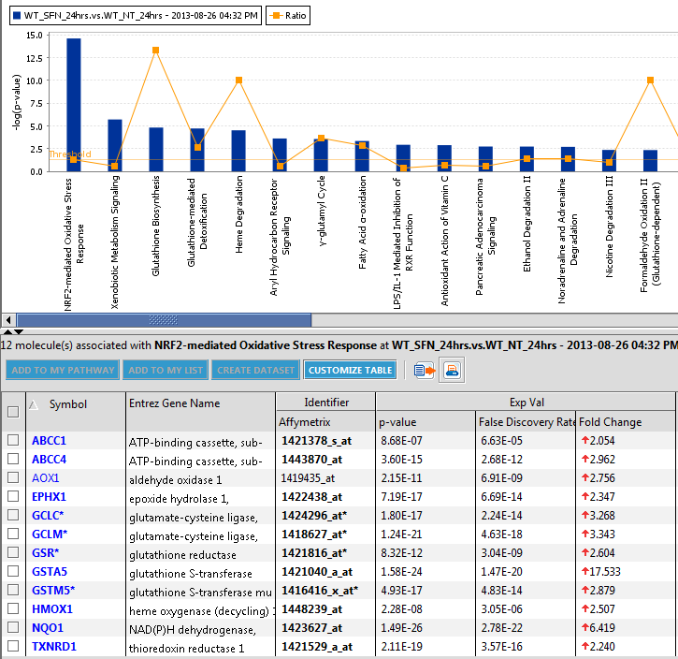
All the DEGs in the pathway are up-regulated
Nrf2-mediated oxidative stress in wild type strain at 24 hours

Slide 31
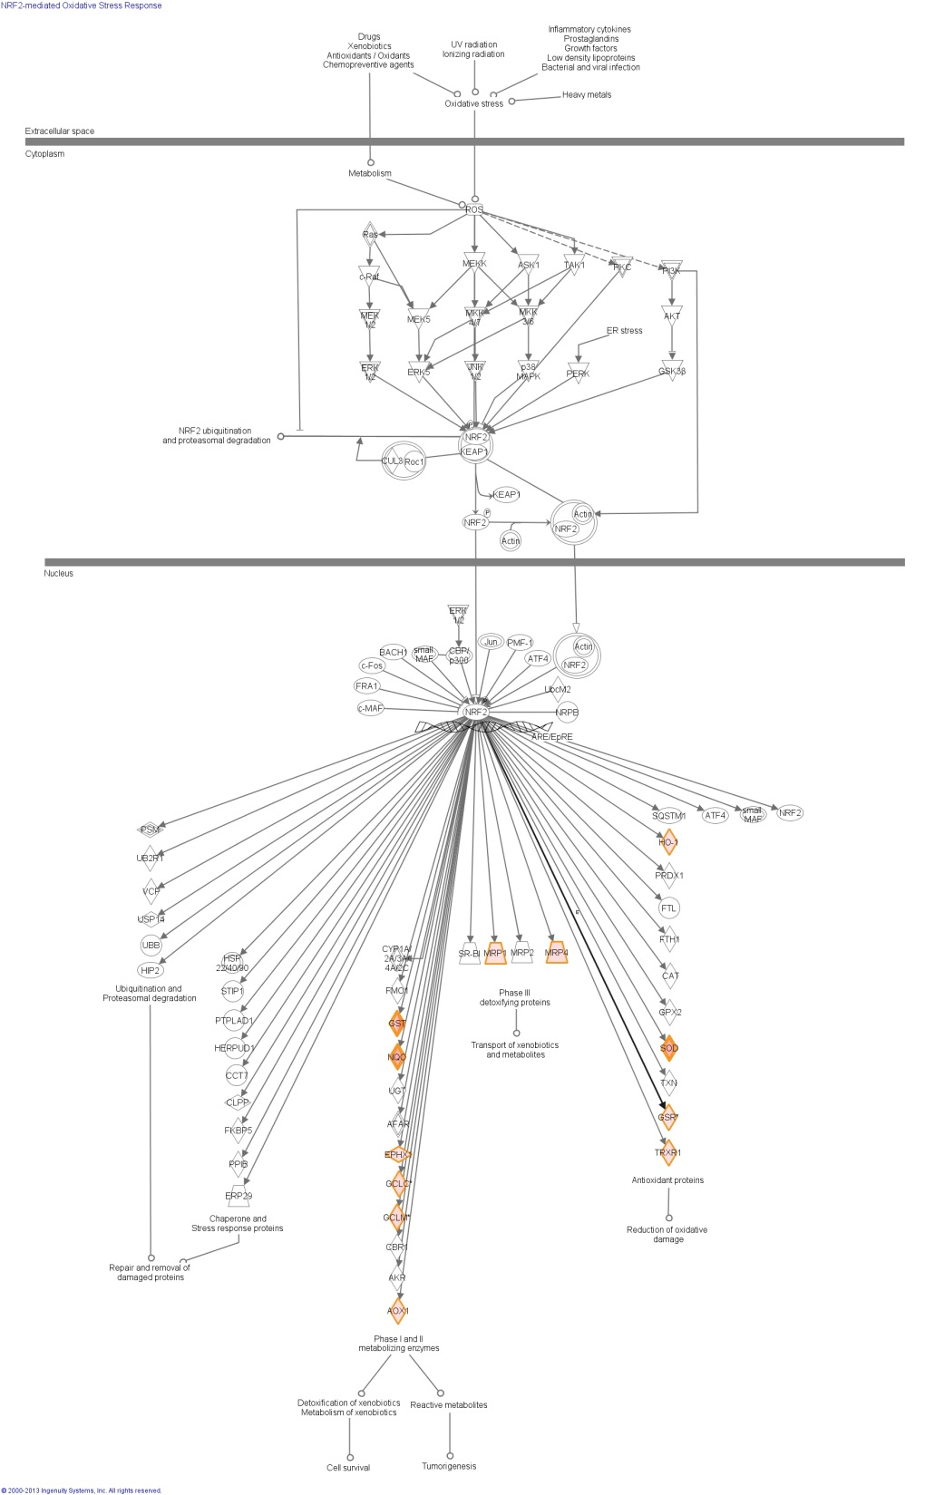
WT_SFN_24hr vs. WT_NT_24 hr
By all means, ONLY exists in the wild type strain

Slide 32
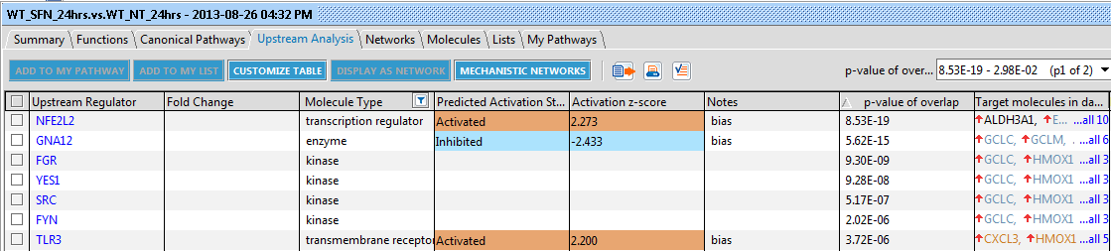
Three upstream regulators

Slide 33
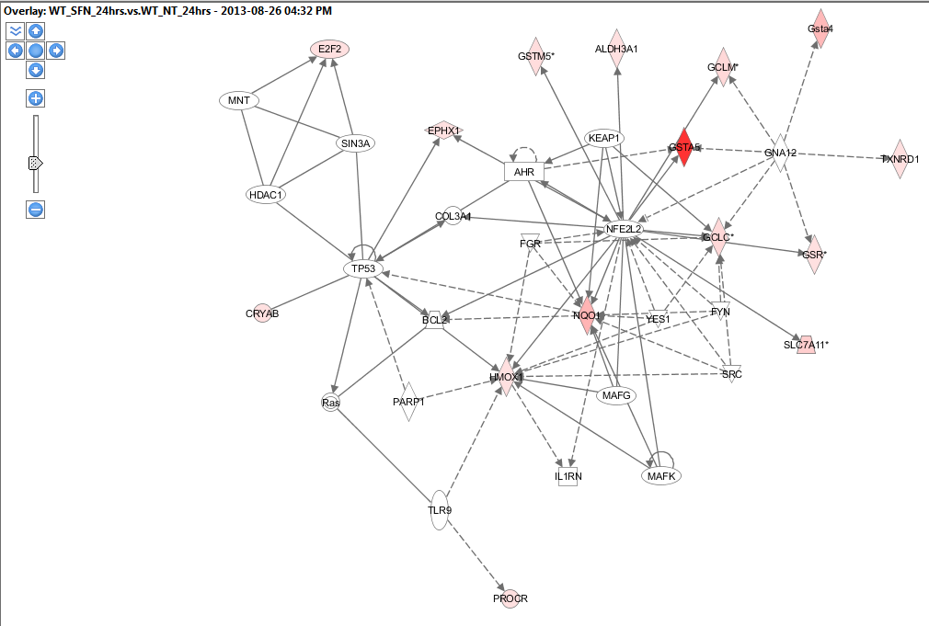
Cell death and survival, cancer, hematological disease

Slide 34
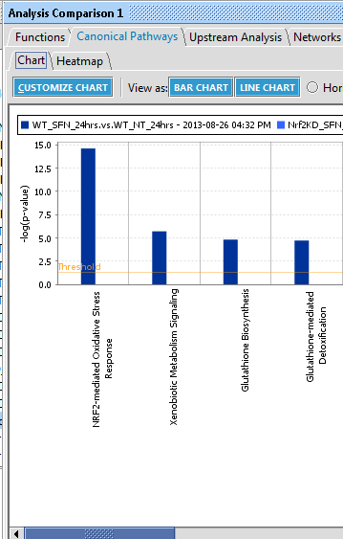
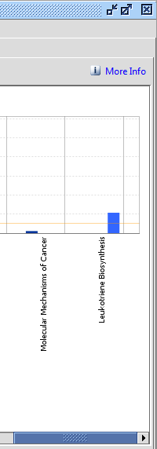
Comparison with Nrf2 KD – 24 hrs
In Nrf2 KO
In W.T.

Slide 35
Parametric approach summary
Statistics distribution based test (hyper geometric/FET)
And, there are a few violations (will be addressed shortly)
Knowledgebase used matters
Hands on practice on IPA

Slide 36
Now, it is your turn
Hands on practice on both parametric and non-parametric

Slide 37
Ingenuity Pathway Analysis

Slide 38
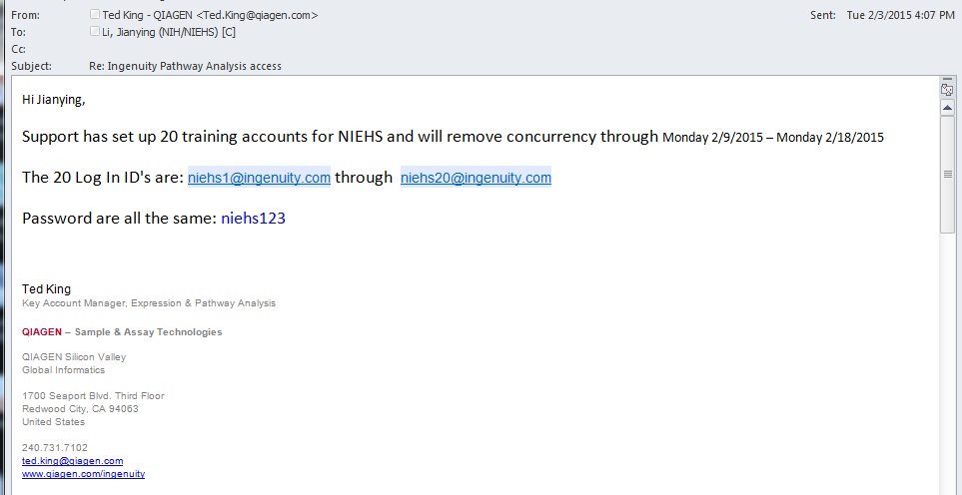
Ingenuity Pathway Analysis

Slide 39
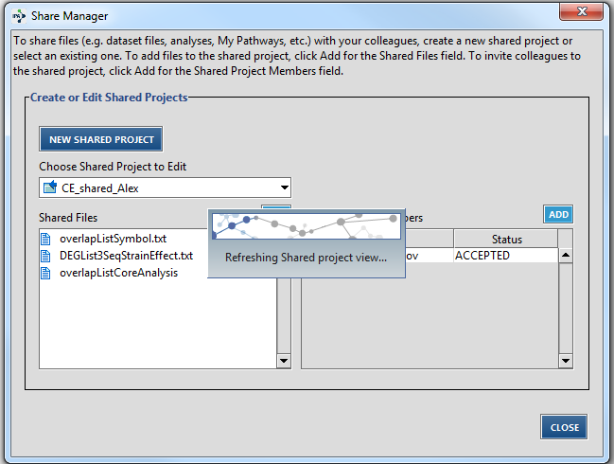
Sharing a project

Slide 40
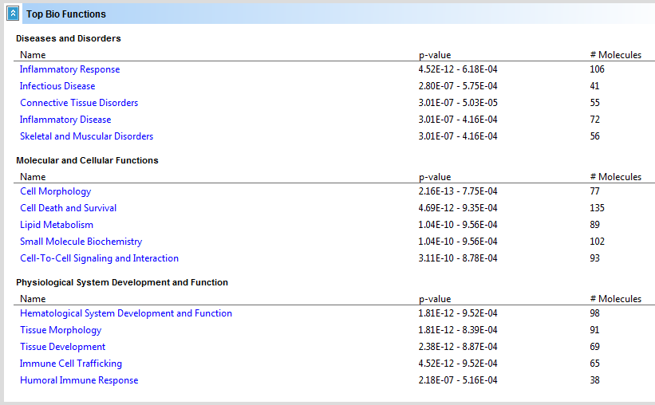
Bio function associated -- IPA

Slide 41
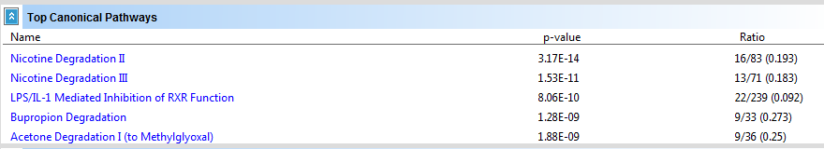
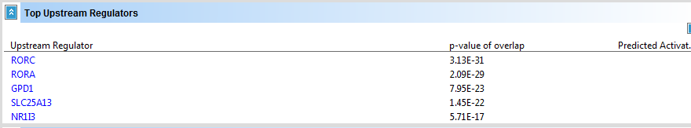
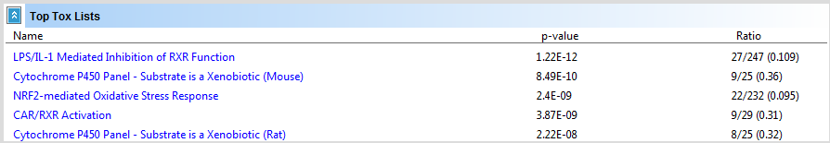
Other pathways (IPA – cont.)

Slide 42
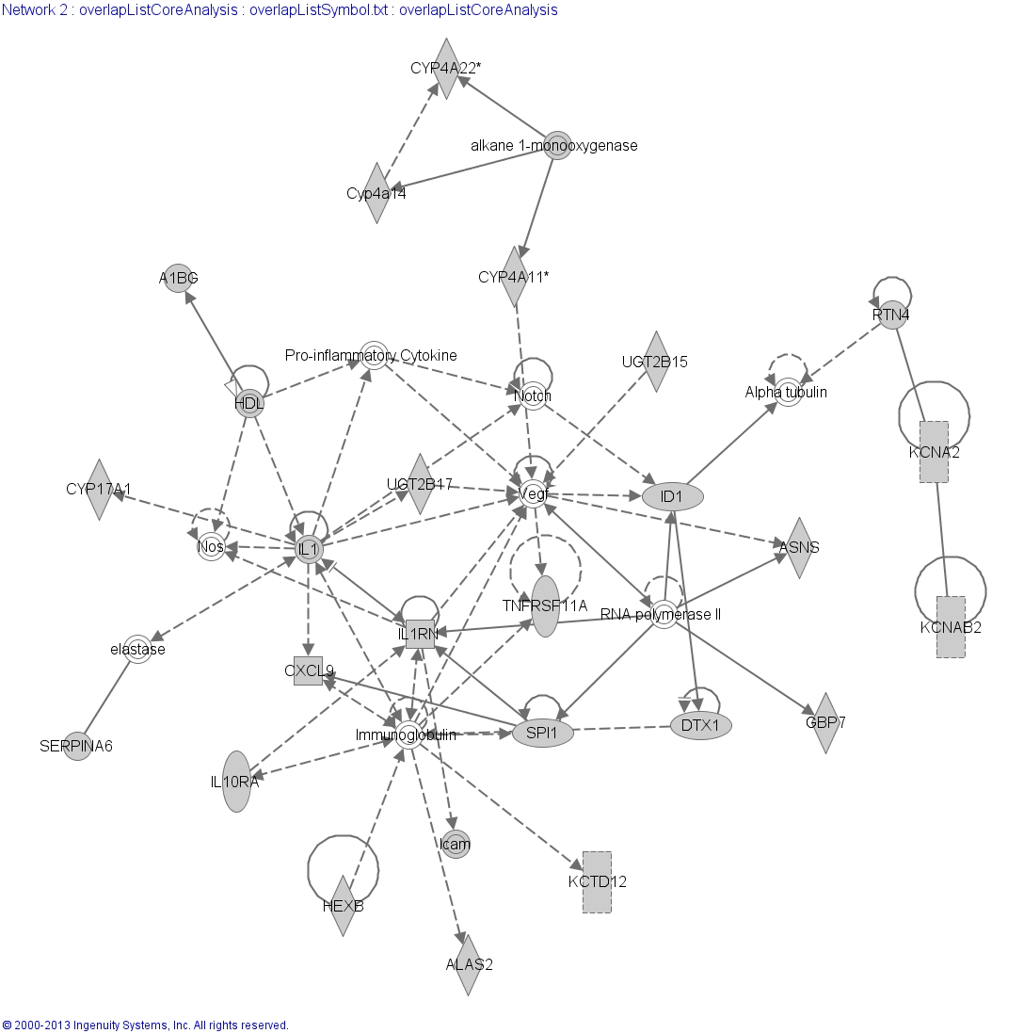
Lipid metabolism, endocrine system development and function

Slide 43
A non-parametric approach
Based on Kolmogorov-Smirnov (K-S) test
Compare a sample empirical distribution function to the reference distribution
Or, compare two sample empirical distribution functions
The test is performed in relevant to different null hypothesis setting

Slide 44
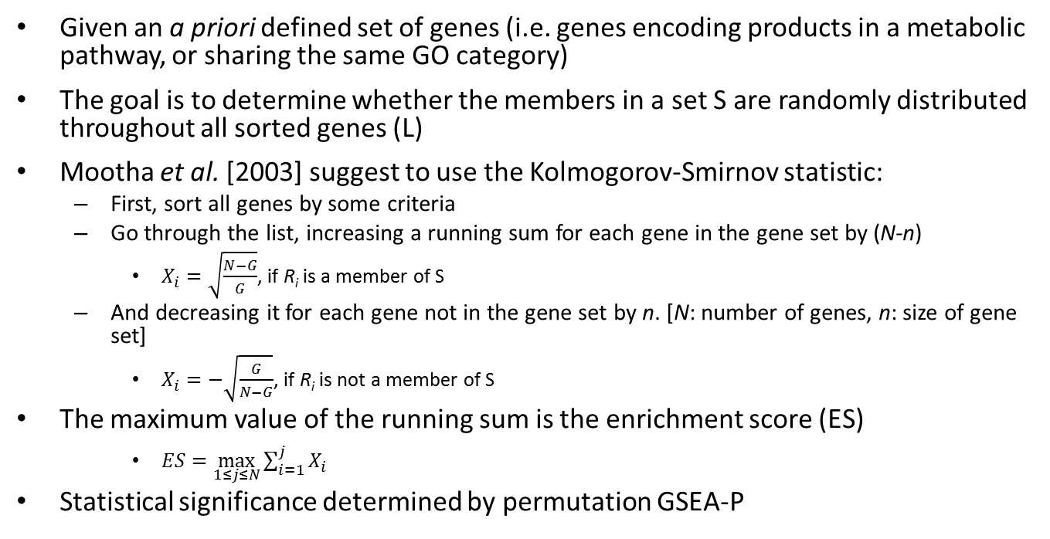
Gene set enrichment analysis (GSEA)
Given an a priori defined set of genes (i.e. genes encoding products in a metabolic pathway, or sharing the same GO category)
The goal is to determine whether the members in a set S are randomly distributed throughout all sorted genes (L)
Mootha et al. [2003] suggest to use the Kolmogorov-Smirnov statistic:
First, sort all genes by some criteria
Go through the list, increasing a running sum for each gene in the gene set by (N-n)
$X_{i}=\sqrt{\frac{N−G}{G}}$, if R_{i} is a member of S
And decreasing it for each gene not in the gene set by n. [N: number of genes, n: size of gene set]
$X_{i}=−\sqrt{\frac{G}{N−G}}$, if R_{i} is not a member of S
The maximum value of the running sum is the enrichment score (ES)
$ES=\max_{1≤j≤N}{\sum_{i=1}^{j}{X_{i}}}$
Statistical significance determined by permutation GSEA-P
Just FYI

Slide 45
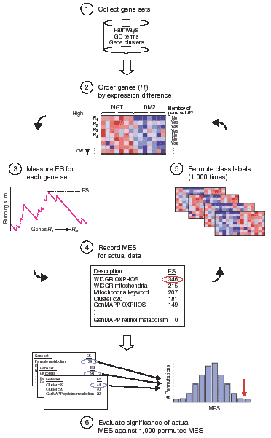
Mootha et al., Nature Genetics, 2003, 34(3):267-273

Slide 46
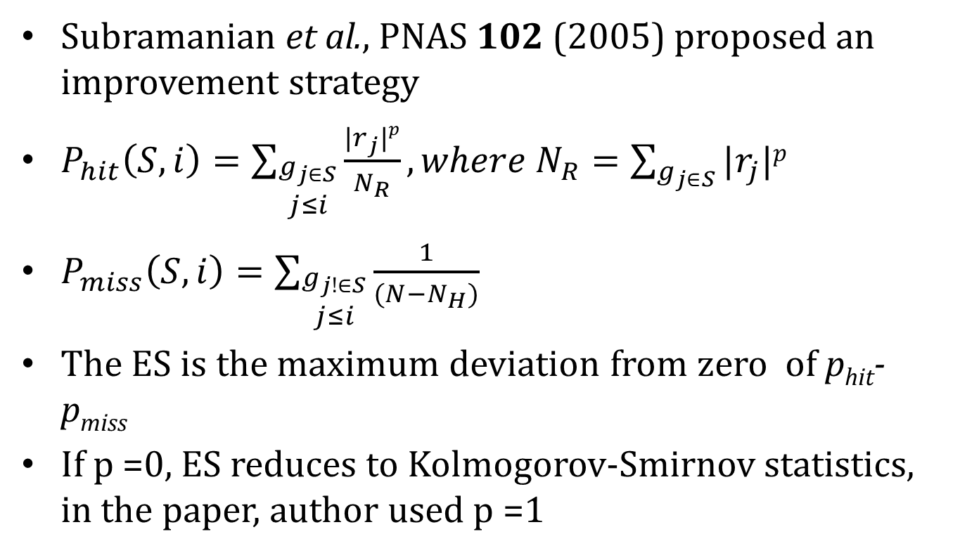
Improved KS statistics tests
Subramanian et al., PNAS 102 (2005) proposed an improvement strategy
$P_{hit}\left(S,i\right)=\sum_{\begin{aligned}g_{j∈S} \\ j≤i\end{aligned}}{\frac{|r_{j}|p}{N_{R}}},where N_{R}=\sum_{g_{j∈S}}{|r_{j}|p}$
$P_{miss}\left(S,i\right)=\sum_{\begin{aligned}g_{j!∈S} \\ j≤i\end{aligned}}{\frac{1}{(N−N_{H})}}$
The ES is the maximum deviation from zero of p_{hit}-p_{miss}
If p =0, ES reduces to Kolmogorov-Smirnov statistics, in the paper, author used p =1
Another FYI page

Slide 47
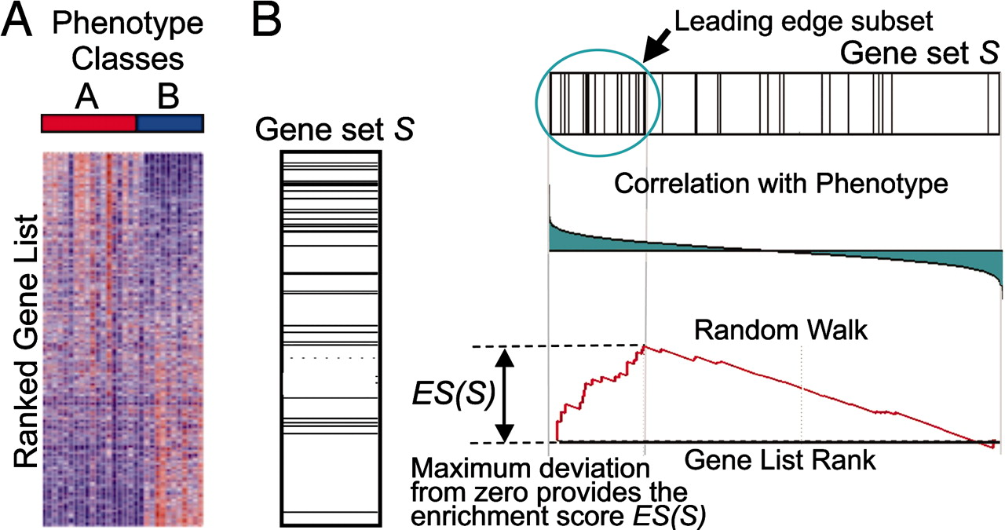
A GSEA overview illustrating the method.
Subramanian A et al. PNAS 2005;102:15545-15550
©2005 by National Academy of Sciences
Notes:
A GSEA overview illustrating the method. (A) An expression data set sorted by correlation with phenotype, the corresponding heat map, and the “gene tags,” i.e., location of genes from a set S within the sorted list. (B) Plot of the running sum for S in the data set, including the location of the maximum enrichment score (ES) and the leading-edge subset.

Slide 48
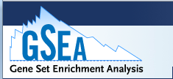
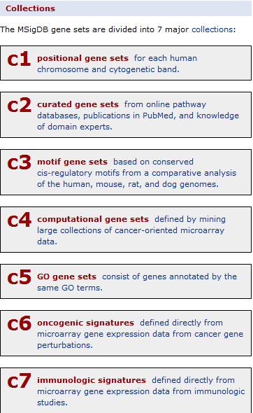
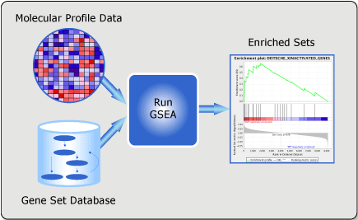
GSEA web-portal
http://www.broadinstitute.org/gsea/msigdb/index.jsp
http://www.broadinstitute.org/gsea/doc/GSEAUserGuide.pdf

Slide 49
More on IPA
IPA Analysis help/manual: http://ingenuity.force.com/ipa
IPA Training resources is here: http://ingenuity.force.com/ipa/IPATutorials?id=kA150000000TPy1
Online Live Training Session registration: http://www.ingenuity.com/products/ipa#/?tab=training

Slide 50
Click to download

Slide 51
Provide your email

Slide 52

This is the icon you need
to click to launch

Slide 53
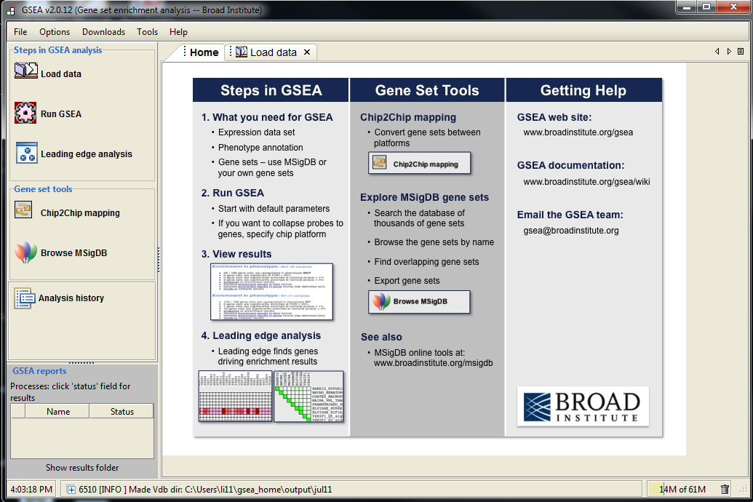
Step 1
Step 2
Step 3

Slide 54
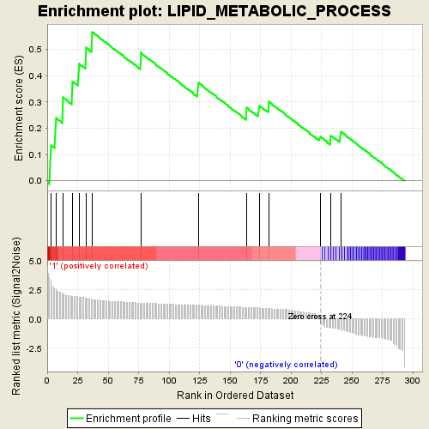
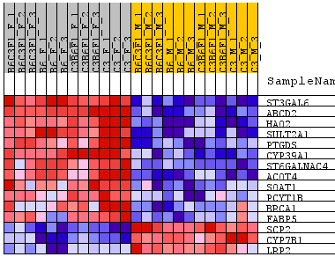
Lipid metabolism enriched -- GSEA

Slide 55
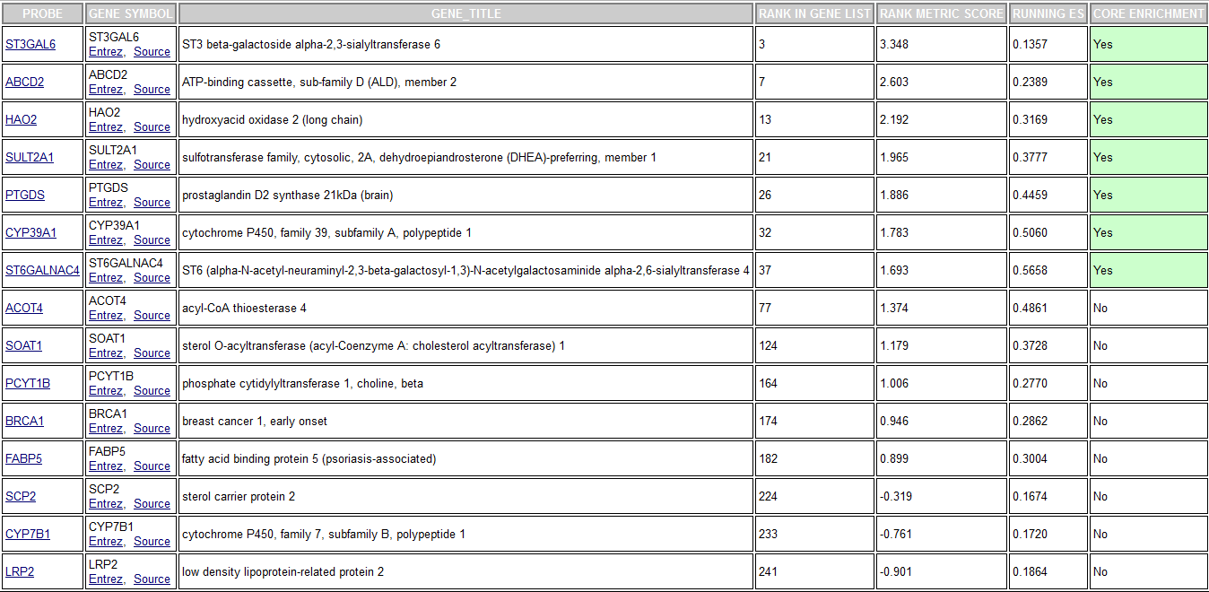
Genes involved (GSEA – cont.)

Slide 56
Some caveat in pathway analysis
Concerns with GO based pathway analysis
Ignore GO hierarchy – treat each term independently
Ignore gene (expression) level/rank
Ignore correlation – assuming genes (in a category) are uncorrelated
Sampling over genes (observation)
All these make p values quite unclear
Facts on the non-parametric approach
Pros
Relax on “strong assumption”
Customized gene set is allowed
Cons
Computationally intensive
Some concerns on the statistical power

Slide 57
The universe matters
It is important to choose the universe correctly
Case 1: universe is all genes in the genome
 | DEGs | Non-DEGs | Total
In GO | 10 | 30 | 40
Not in GO | 390 | 3570 | 3960
Total | 400 | 3600 | 4000
p=0.049
Case 2: universe is only expressed genes
 | DEGs | Non-DEGs | Total
In GO | 10 | 30 | 40
Not in GO | 390 | 570 | 960
Total | 400 | 600 | 1000
p=0.0048

Slide 58
Sets are overlapped
A
B
Set B is enriched only because of it overlap with set A

Slide 59
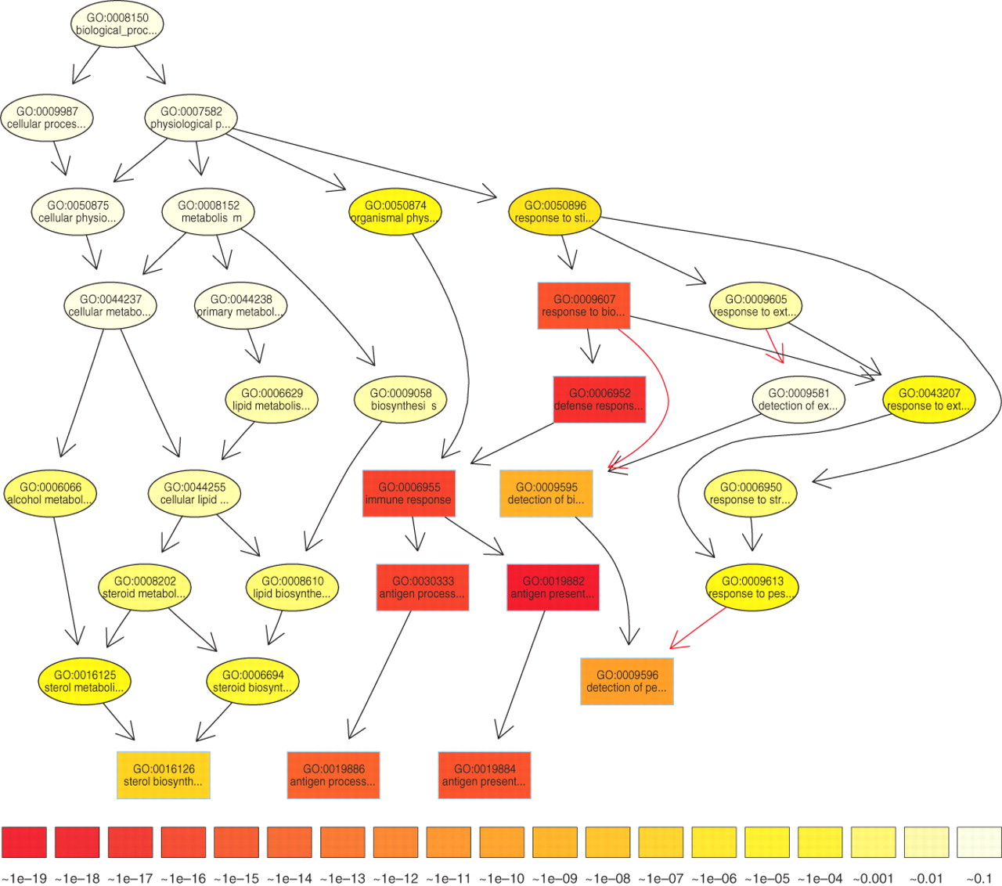

The subgraph induced by the 10 most significant GO terms identified by a current state-of-the-art method for scoring GO terms for enrichment.
TopGO’s elimination algorithm
Test the leaf sets first. If significant,
remove its “genes” before testing its
ancestor sets
TopGO’s weight algorithm
The genes are weighted by their relevance
in the significant nodes.
The enrichment score of a parent (gene
node u) is compared with the scores of
its children.
Children with a better score than u
represent the interesting genes better.
Therefore, their significance is increased
Children with a lower score than u have
their significance reduced.
Alexa A et al. Bioinformatics 2006;22:1600-1607
© The Author 2006. Published by Oxford University Press. All rights reserved. For Permissions, please email: journals.permissions@oxfordjournals.org
Notes:
The subgraph induced by the 10 most significant GO terms identified by a current state-of-the-art method for scoring GO terms for enrichment. Boxes indicate the 10 most significant terms. Box color represents significance, ranging from dark red (most significant) to light yellow (least significant). The numbers in the legend represent the magnitude of the raw p-values associated with the respective color. Black arrows indicate is–a relationships and red arrows part–of relationships.

Slide 60
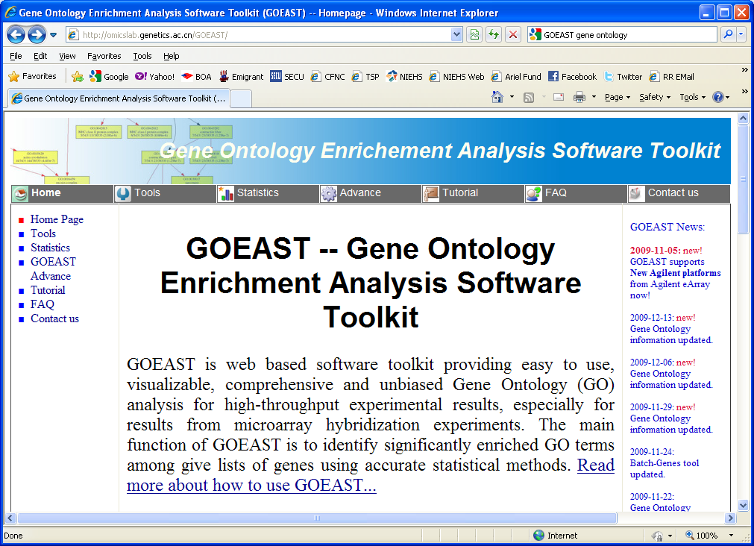
GOEAST – modification incorporated
Open web browser and navigate to: http://omicslab.genetics.ac.cn/GOEAST/
At the header tool bar, click on Tutorial
Notes:
60

Slide 61
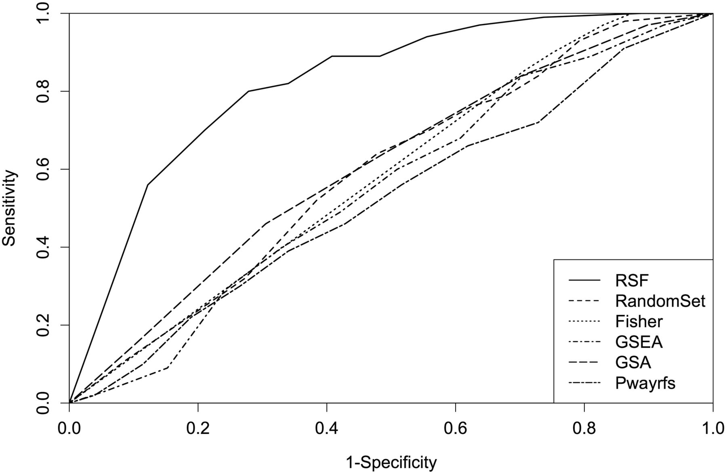
Comparison of performances of RSF, random-set, Fisher’s exact test, GSEA, GSA and Pwayrfsurvival using simulated expression data.
Chen X , and Ishwaran H Bioinformatics 2013;29:99-105
© The Author(s) 2012. Published by Oxford University Press. All rights reserved. For Permissions, please e-mail: journals.permissions@oup.com
Notes:
Comparison of performances of RSF, random-set, Fisher’s exact test, GSEA, GSA and Pwayrfsurvival using simulated expression data. This figure shows the ROC curves for simulation scenario 2 of Table 1

Slide 62
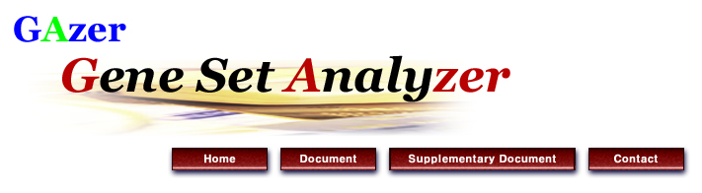
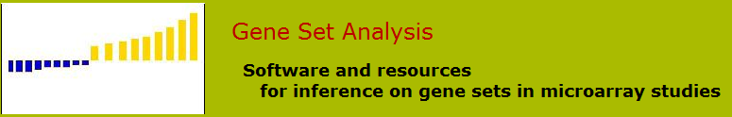





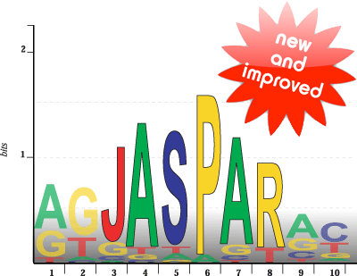





Slide 63
http://www-stat.stanford.edu/~tibs/GSA/
http://www.netsci.org/Resources/Software/Bioinform/pathwayanalysis.html
http://www.broadinstitute.org/gsea/index.jsp
http://david.abcc.ncifcrf.gov/
http://www.biocarta.com/
http://web.expasy.org/pathways/
http://www.genmapp.org/
http://www.genome.jp/kegg/
http://www.ingenuity.com/
http://www.genego.com/metacore.php
http://www.geneontology.org/
http://omicslab.genetics.ac.cn/GOEAST/tutorial.php
http://expressome.kobic.re.kr/GAzer/document.jsp
http://www.biobase-international.com/products
http://jaspar.genereg.net/

Slide 64
Pathway analysis summary
Two major statistics approaches
Parametric vs. non-parametrics
Three major databases
Gene Ontology
KEGG
Transfac & transpath
A few popular applications
DAVID (free online)
GSEA (online and desktop java application)
GSA (R –package)
Ingenuity Pathway Analysis (licensed based)
Biobase/JASPER (license based)
GeneGO (license based)

